Slide 1
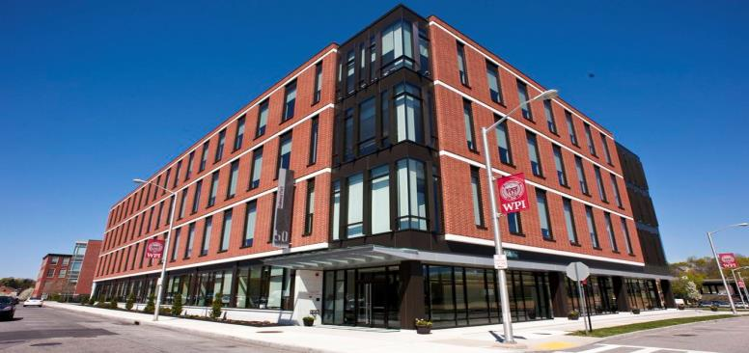
Bioprocessing and Biomanufacturing
Kamal Rashid, Ph.D.
Director & Research Professor
Biomanufacturing Education & Training Center (BETC)
Prepared for BB1035 Class

Slide 2
Bioprocessing
Cells
Reactor
Media
Conversion Stage
DO pH Asepsis Agitation Aeration
Product Separation & Purification
Cell Disruption Centrifugation Filtration
Chromatography Fill & Finish

Slide 3
Biotechnology Progress
More than 250 healthcare products and vaccines
More than 50 bio-refineries built in North America to produce:
Biofuels
Chemicals from renewable biomass
More than 13 million farmers around the globe use agricultural biotechnology to:
Increase yield
Improve food quality
Control plant diseases
Control plant diseases
Improve food quality

Slide 4
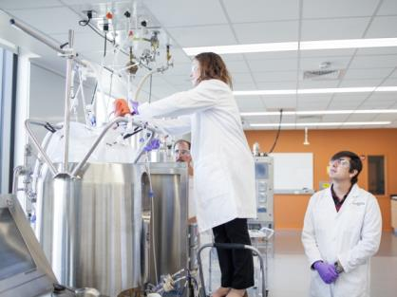
Bioprocessing Deals with Living Cells
Microbial Cells
Animal Cells
Insect Cells
Plant Cells

Slide 5
What is a Cell ?
A cell is a cooperative of molecules capable of reproducing itself.
To do so a cell must have a number of components:
A set of instructions
The production facility for making the molecules that will form the daughter cells
A mechanism for dividing one cell into two
A defined boundary between the cell and its environment across which nutrients are imported and wastes exported
The instructions are encoded in the sequence of DNA
Chromosomes play two roles:
Duplicate and segregate to two daughter cells
Express their genes to produce two types of proteins:
Those that regulate the cell cycle
Those that form the components of the daughter cells

Slide 6
Microbial Cells/Fermentation
The term fermentation is derived from the Latin verb fervere, to boil,
The process for the production of a product by mass culture of microorganisms
( microbiologists)
An energy generating process in which organic compounds act as both electron donors and acceptors (Biochemists)
Fermentation: An art from the past, a Skill for the future

Slide 7
Fermentation: Industrial
Microorganisms convert raw materials into useful products
A set of steps to produce a product
The process utilize well characterized cells
Wild type
Mutant
Genetically engineered
The crude product after a set of well defined purification steps, leads to a consistent product

Slide 8
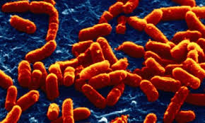
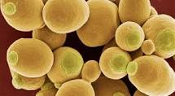
Choice of Microbial Cell System
Most Common
Bacteria
E. Coli
Lactobacillus
Bacillus
Yeast
Saccharomyces
Pichia

Slide 9
Growth of a typical microorganism
Lag Phase
Log or exponential Phase
Deceleration Phase
Stationary or Plateau Phase
Death Phase
Nutrient Depletion
Accumulation of toxic metabolites
This situation is applicable in batch cultures
Growth can be extended by addition of fresh medium
( Continuous culture)

Slide 10
Factors Affecting Microbial Growth
Availability of nutrients
Nutrient quality
Temperature
pH
Accumulation of toxic metabolites
Rate and nature of mixing usually change with every 10 fold increase
Oxygen demand

Slide 11
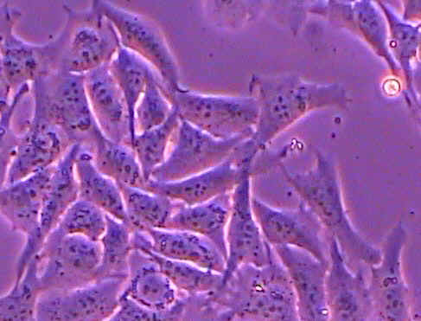
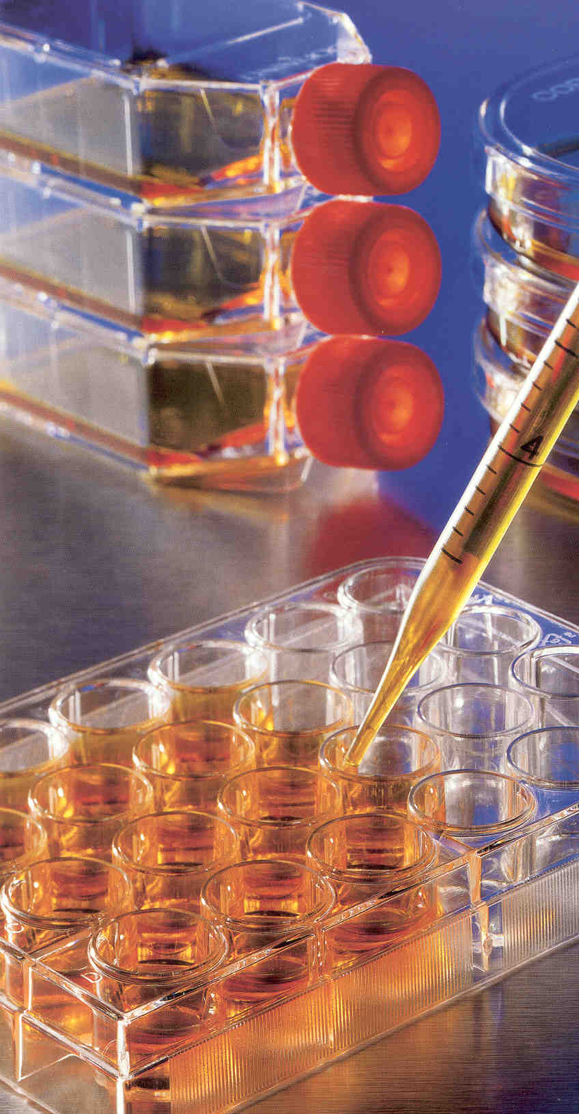
Animal cells and Bioprocessing
BHK21
Vero
HEK 293
CHO
HeLa
3T3 Cells
Hundreds of other cell lines
$1 invested in vaccine production saves $10 in future costs of health care

Slide 12
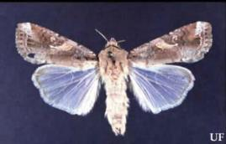
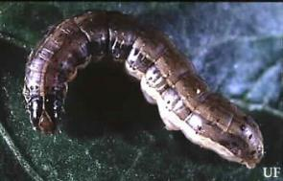
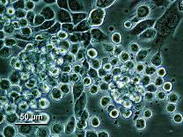
Insect Cell and Bioprocessing
Sf9 Cell Line , Sf 21
Common name: Fall Armyworm
Scientific Name: Spodoptera frugperda

Slide 13
Cell Growth: Potential Problems
Concerns with viability
Concerns with Stability
Concerns with media: Composition Preparation and Sterilization
Concerns with bio-waste containment

Slide 14
Microbial vs Mammalian
Microbial:
Shorter doubling time
Shear resistant
Suspension culture
Product conc. High
Product value can be low to moderate
Cell density very high
Genetic stability not a problem
Mammalian:
Longer doubling time
Shear sensitive
Anchorage/Suspension
Product conc. Low
Product value high to very high
Cell density low
Genetic stability often a problem

Slide 15
Why Animal Cells ?
Post translational modifications and folding of complex proteins are not shared by microorganisms.
Vaccines are only produced in animal cell cultures.
Antibody production is purely cell culture
At least at the present time

Slide 16
The Cell is a Factory
Cell Debris
(protein, DNA, Virus)
Control of Culture Condition
Cells
Medium
Product
Control of Expression
-inducers
-hormones
-nutrients
Control of Growth
Toxic Byproduct

Slide 17
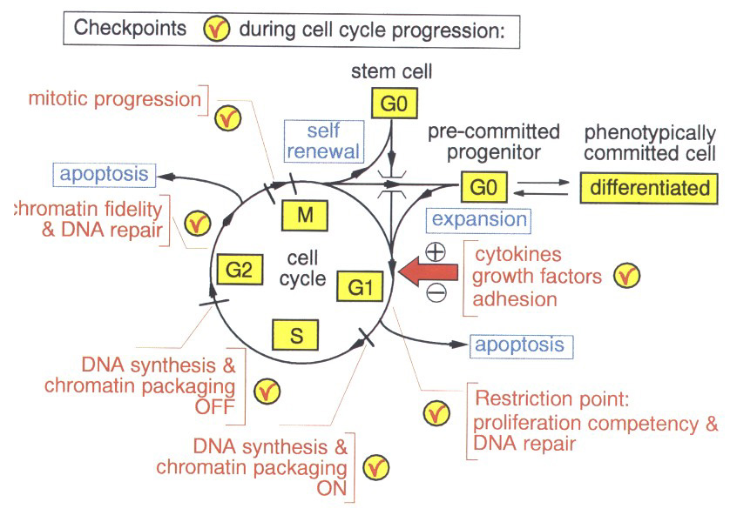
Cell Cycle and Productivity Improvement

Slide 18
Biomanufacturing
Production of a wide range of biological products for the emerging global economy
Research, development and applications in the fields of:
Biotechnology
Bioengineering
Biodetection
Biomaterials
Biocomputations and
Bioenergy
Have an impact on products created and the way they are produced.

Slide 19
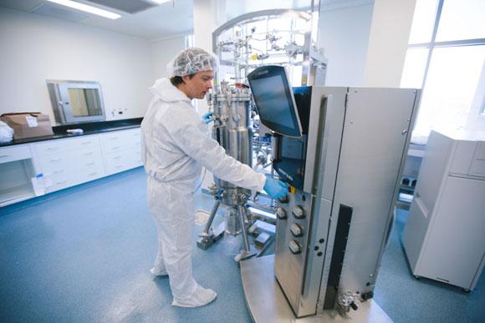
Biomanufacturing = Scale Up
From mg Kg
Parameters change
Performance remain constant

Slide 20
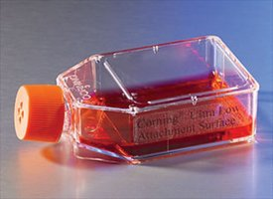
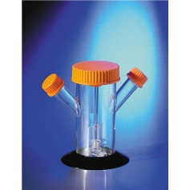
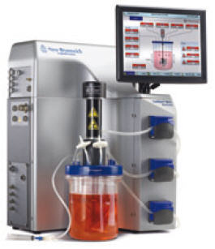
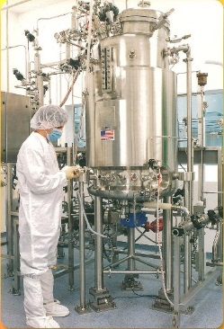
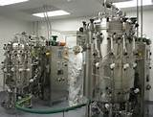
Scale-Up of Animal cells in Culture
T-Flask or Spinner Flask
Bench-Scale Bioreactor
Pilot-Scale Bioreactor
Production-Scale Bioreactors
From mg to Kg
to
Tons

Slide 21

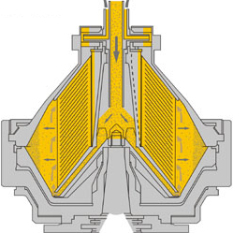
A Typical Biomanufacturing Process Flow
Cell Culture/Clarification
Cell bank
vial
Spinner or Shake Flask
Seed Bioreactors
Production
Bioreactor
Centrifugation
Depth
Filtration
Clarified
Harvest
Product Capture
Fine Purification
Affinity
Chromatography
low pH Viral
inactivation
Ion Exchange
Chromatography
Hydrophobic
Interaction
Chromatography
Viral Filtration
UF/DF
Bottling

Slide 22
Scale-Up Challenges
It involves living organisms
The organisms are highly selected and/or modified
The organism’s environment is altered in a very complex manner
Alterations lead to variable interactions
Interactions often cause unexpected results

Slide 23
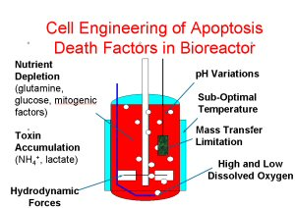

Slide 24
Biologics vs Drugs
Biologics:Manufactured in living systems.
The product is the process
The process must remain the same over time to produce a consistent product.
The living cells that are used for the production are very sensitive to even minor changes.
Make sure the structure is the same
Make sure the functionality is the same
Drugs: Typically produced through chemical synthesis.
A drug manufacturer can change the process and analyze the finished product to make sure it is the same as before the change.

Slide 25
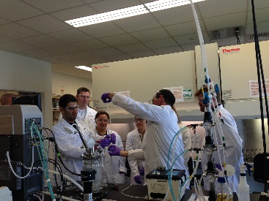
Questions

